Slide 1
NNC Utility perspective: compliance alternatives;
Technology Choices;
Utility Customer Impacts… from EPA’s Numeric Nutrient Criteria
Ed Cordova, PE
JEA
Environmental Services

Slide 2
Outline
Compliance Alternatives
Technology Choices to Meet Criteria
Utility Customer Impacts
Concerns of Utilities and Their Commentary to EPA
Current Legal and Legislative Efforts
Implications for Industrial Pretreatment Programs

Slide 3
Compliance Alternatives
EPA explains it’s cost estimate based on the supposition of widespread exemptions from the criteria to achieve compliance
  Lake criteria adjustment or reallocation procedure of the DPV methodology for estuary protection
  Site-specific alternative criteria
  Variances
  UAAs and resulting changes to designated
  Mixing zones
If you do not get a waiver/exemption/magic fairy dust …
Notes:
Mixing zones are given as an alternative as well, but this would only be available if TN and TP concentrations in the water body were below the proposed criteria. In many cases, such as existing TMDLs this is not true. Also, for many natural water bodies, this is not true.

Slide 4
Compliance Alts for Wastewater Utilities
Absent some type of waiver/exemption/alternative standard, RO is required or nearly 100% reuse.
EPA’s Freshwater Criteria vary from
  0.01-0.5 mg/L TP
  0.5-1.9 mg/L TN
What is achievable (best in class now)
  The P limit is achievable without exotic technology (Best in Class is approx 0.1-0.2 mg/L).
  The N limits are not achievable without reverse osmosis or other technology (Best in Class is approx 2 mg/L) .

Slide 5
Treatment or Reuse?
Yes.
100% reuse is rarely feasible or cost effective compared to even exotic treatment (site/community specific).
Treatment is technologically achievable. It is a question of societal and ecological benefit, not technology.
There is generally not significant benefit to going beyond current levels in most cases:
  Our current technologies in place removes almost all of the bioavailable N and P (algae forming stuff).
  The additional amount that the NNC rule is requiring to be removed using RO is generally considered non-bioavailable.

Slide 6
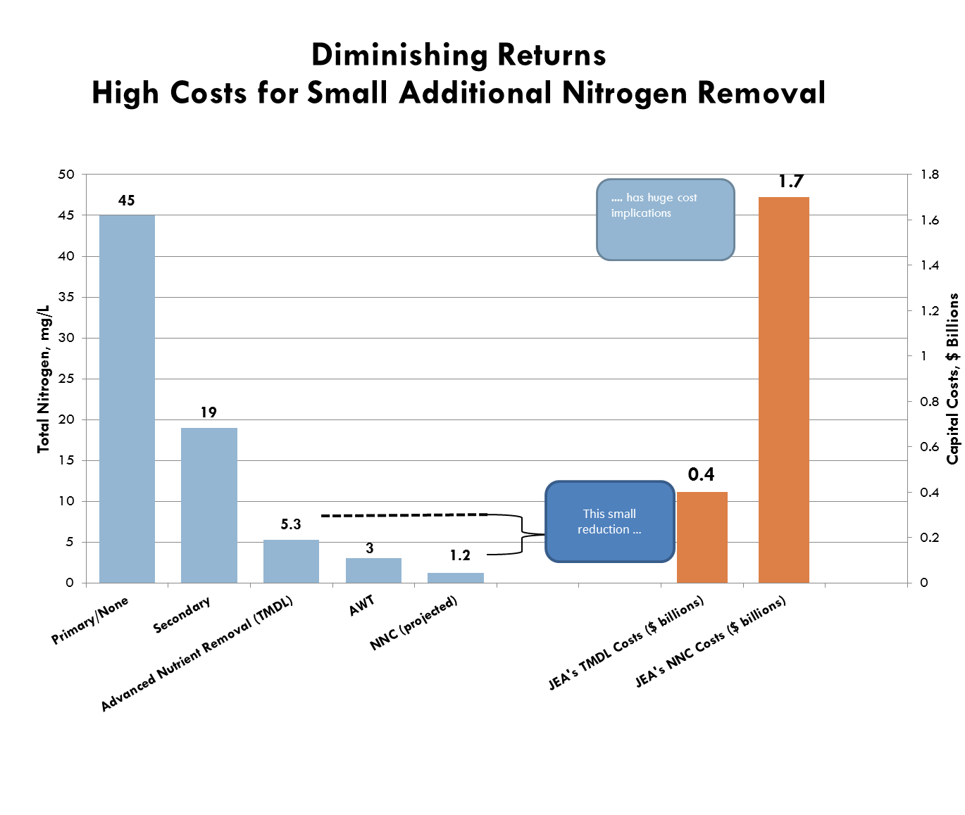
One case study ..

Slide 7
The NNC Rule Will Double the Average Residential Water/Wastewater Bill For those not granted an Exemption/waiver
An Increase of $700/yr
for those Residences
Source: Carollo Engineers, COSTS FOR UTILITIES AND THEIR RATEPAYERS TO COMPLY WITH EPA NUMERIC NUTRIENT CRITERIA FOR FRESHWATER, November 1, 2010

Slide 8
What is the Utility Customer Impact?
Depends who you are, where you are.
If waiver, maybe 0
If treatment average $700/res/yr.

Slide 9
Utility Concerns and Commentary on EPA’s Rule
Concern: Water/Sewer Increase $700/year for average Florida resident for marginal environmental gain
Commentary: Utilities Support Numeric Criteria as
Enhancement of Florida’s Program
Displaces existing, science based and site specific numeric criteria, such as the Lower St. Johns TMDL, Tampa Bay, etc. (Delays restoration of these waters)
Results in the wrong standard for many waters
Disproportionately impacts poor and under-privileged
Want “the right” numbers
Litigating
Urging EPA to adopt existing EPA approved TMDLs as the site specific numeric criteria for those waters

Slide 10
Potential Impacts to Muni Stormwater
Surface water cleanup is much more expensive than true point sources per pound removed. (dilute, not closed system … )
While MS4s have historically been asked to comply to the MEP standard, two things are changing that now.
  Giattina letter to the states of April 2010, asking for more clear and measurable conditions in permits.
  EPA’s apparent strategy to move away from BMPs in MS4s to numeric criteria.
EPA’s displacement of TMDL approach with NNC takes away water quality credit trading tool

Slide 11
Status of legal / Legislative Efforts
Numerous Lawsuits Challenging
  Original Need Determination that brought this to Florida
  Underlying Science of Standards
Numerous regulated interests have repeatedly engaged DEP through the comment process
  Unity of message from a broad group (cities/counties/utilities/ag/reg industry)
  Very little of commentary was taken into final freshwater rule
Florida Delegation Has Appealed to EPA
  To take more time to …
    Review / Revise poorly derived criteria
    Do an independent peer review
    Commission an independent cost analysis (EPA says 130M, Others say Billions)
  Latest - Letter from Dem Senator Bill Nelson urging last 2 items above

Slide 12
Status of legal / Legislative Efforts
(Cont.)
Florida Governor and Cabinet firmly aligned against EPA’s actions
  Have pledged to vigorously oppose
  Dept. of Ag and Attorney General participating in suits against EPA
Florida Legislature Engaged
  HB 239 Passed Committee Last Week and will be deliberated
  Requires DEP to NOT IMPLEMENT EPAs criteria in Florida until thoroughly vetted
  Requires DEP to submit to EPA FL TMDLs for consideration as SSACs

Slide 13
Likely Industrial Pretreatment Program Implications
Changes to your program from:
  Exemption/Waiver = No Change
  100% Reuse = No Change
  Treatment = Eval of Nutrient Local Limits (protect wwtp)
  = Eval of surcharge limits (recoup costs)

