Slide 1
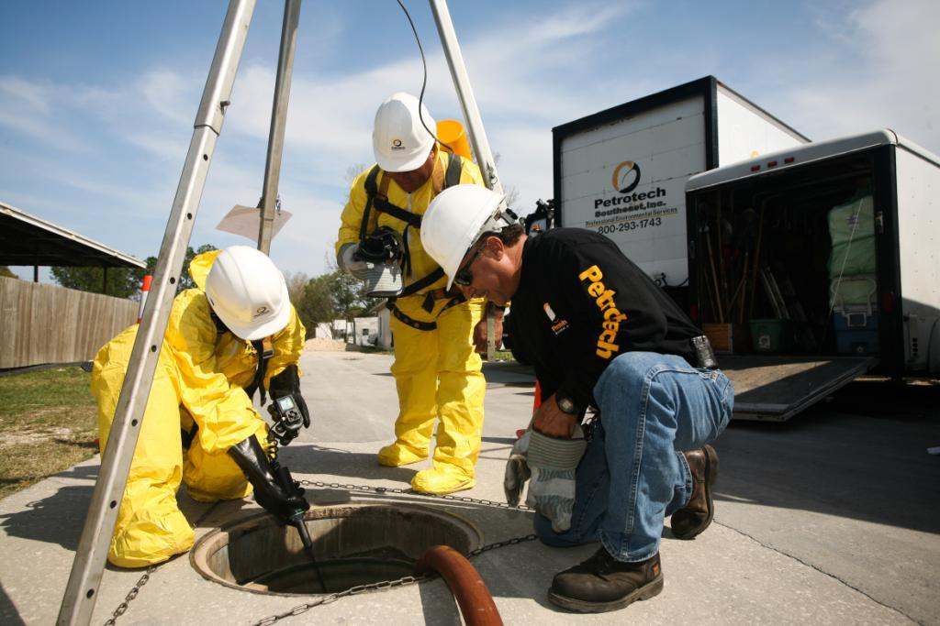

Petrotech
Southeast, Inc.
Oil Water Separator Maintenance

Slide 2
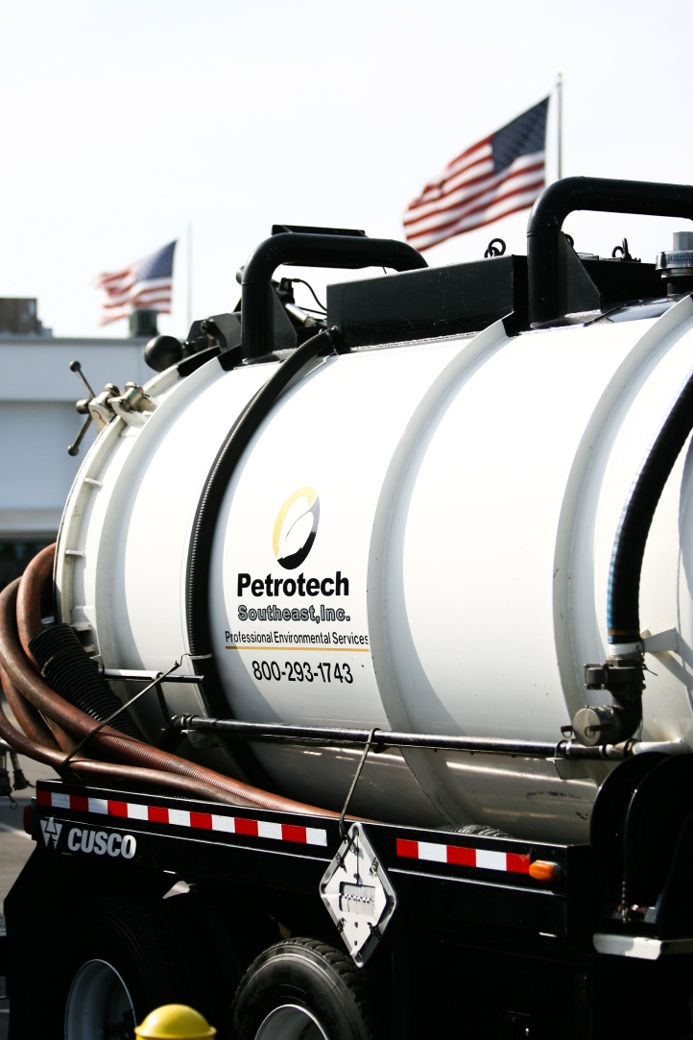

FIPA – OWS Overview
Petrotech Southeast Overview
Oil Water Separator Maintenance
Oil Water Separator Enforcement
Orange County / Orlando Enforcement
Waste Tracking
Lunch!!!
Petrotech
Southeast, Inc.

Slide 3
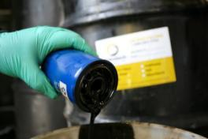
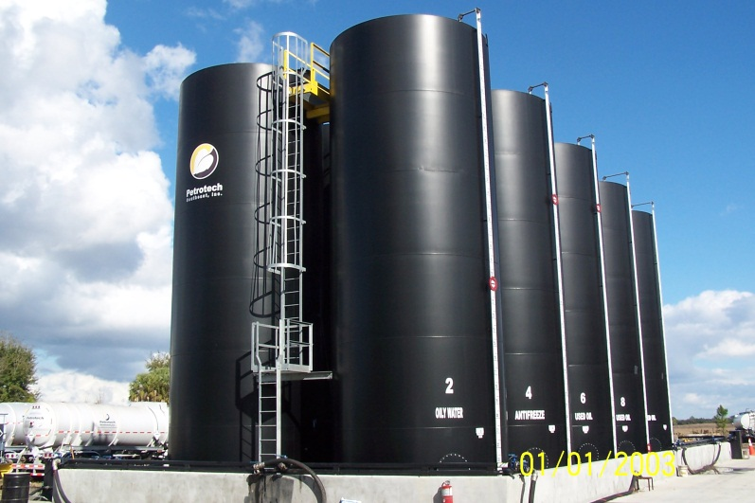
Company Capabilities
Company Overview
  20 years Experience in the Environmental Services Industry
  Family owned and operated
  New 8-Acre, 400K-Gallon Processing Facility
  Full Complement of Environmental Service Offerings
Used Oil Recycling / Fluid Recovery
  Used Oil
  Oil Filters
  Used Antifreeze
  Absorbent Disposal
Registered Used Oil:
  Transporter, Transfer Facility, Processor and
  Marketer
  Filter Transporter, Transfer Facility and
  Processor
Petrotech
Southeast, Inc.

Slide 4
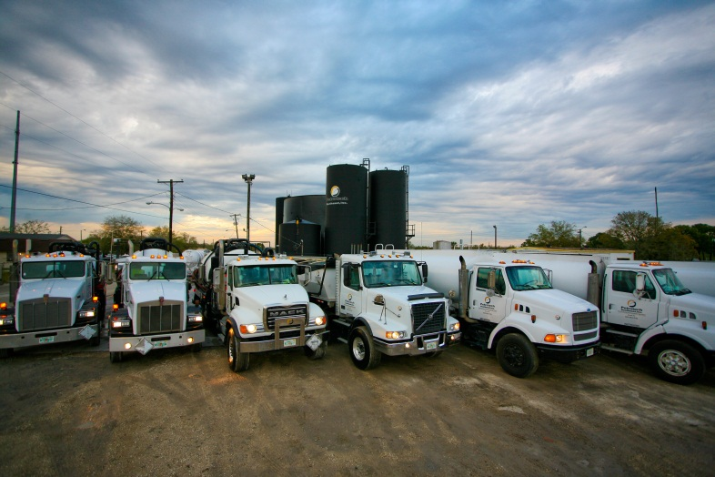
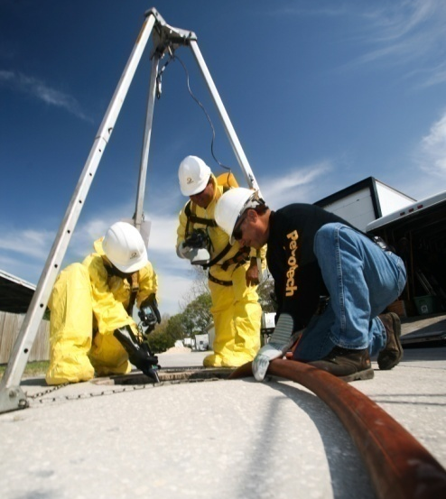
Company Capabilities
Environmental Services
  Vacuum Truck Services
  Oil / Water Separator Cleaning
  Tank Cleaning
  Storm Drain Cleaning Services
  Confined Space Entry Capability
  Soil Excavation, Transportation & Disposal
  Roll-Off Services
  Tanker Services
  Drummed Waste Transportation and Disposal
Emergency Spill Response
  24 Hours / Day, 7 Days / Week
  Capable of handling spills of any size
Petrotech
Southeast, Inc.

Slide 5
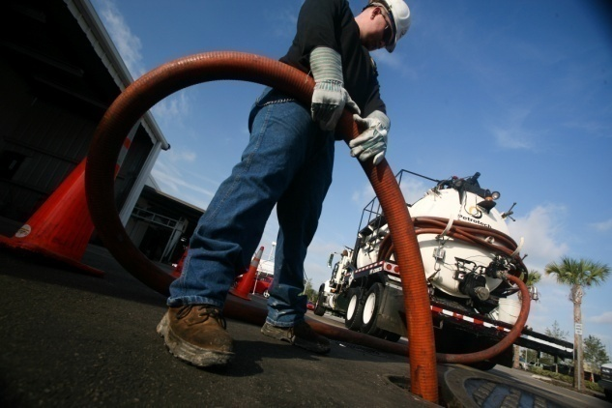
OWS Maintenance
What makes an oil water separator work?
  Gravity
  Time
Routine Maintenance Buys Time
  Many facilities service devices only once or twice per year
  Depending on process and flow rates, may generate 100-500 gallons of sludge
  Some OWS service companies pump only the water because sludge is more expensive to dispose of
  All this leads to reduced volume in the OWS.
  Lower volume = Less time in the OWS
  Routine Maintenance keeps the “working volume” at its highest possible level and gives the device time to work.
  Minimizes load on Wastewater Treatment Plants
Petrotech
Southeast, Inc.

Slide 6
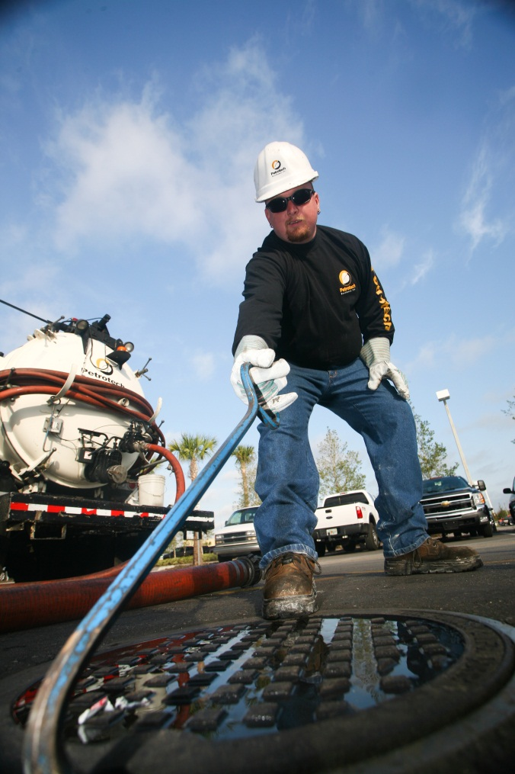
OWS Enforcement
Enforcement is critical
What to Look for…
  Oil / Grease Hauler Manifests Showing Quarterly Service
  Transporter Manifests Showing volume of Liquids and Solids
  If high water / solids ratio, system is likely working
  Is the hauler a used oil transporter?
  Does the generator or hauler have an analytical on file?
  If so, is it current?
  Is the generator waste profile up to date?
  Is the hauler testing for halogens prior to pump-out?
Petrotech
Southeast, Inc.

Slide 7
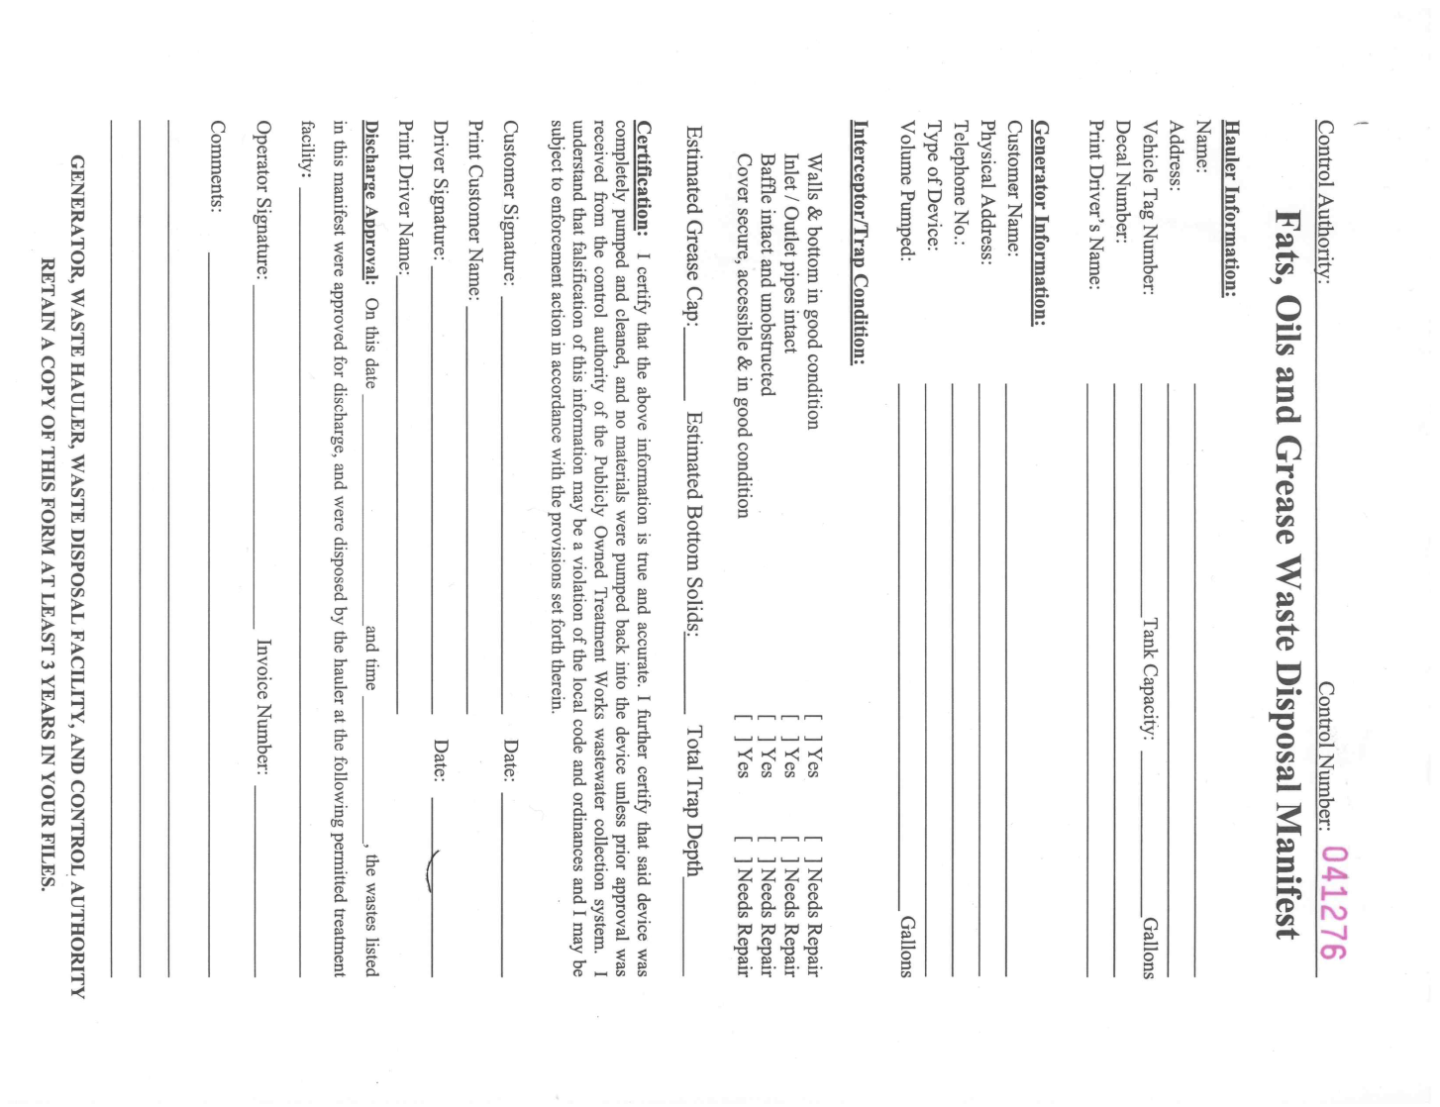
OWS Enforcement
Orlando / Orange County Requirements
  Requires Quarterly Clean-Out
  Hauler Manifest to Include:
    Hauler Information
    Condition of Separator
    Gallons Pumped
      Grease Cap & Bottom Solids
    Disposal Facilities Signatures
    Track every gallon (liquids & solids)
  Original sent to Generator
  One copy sent to Regulator
The End Result…
  SIGNIFICANTLY lower volumes of solids per pump-out
  Functional Systems
  Less load on Wastewater Treatment Plant

Slide 8
Waste Tracking
Data from Hauler & PSI Manifests
Sludge Disposal
Water Disposal
Date | Control Number | Total Manifest Gallons | PSI Manifest Number | PSI WW | PSI WS | Total Gallons | AC Sludge Manifest # | AC Sludge Gallons | PSI Sludge Manifest # | PSI Sludge Gallons | AC Water Manifest # | AC Water Gallons | CBI Water Manifest # | CBI Water Gallons | Status
3/2/2011 | 41256 | 768 | 104343 | 668 | 100 | 768 | 68229 | 100 |  |  | 68229 | 668 |  |  | Complete
3/2/2011 | 41257 | 1691 | 104344 | 1691 | 0 | 1691 |  |  |  |  |  |  | 190271-1 | 1691 | Complete
3/2/2011 | 41259 | 1500 | 104341 | 1500 | 0 | 1500 |  |  |  |  |  |  | 190271-1 | 1500 | Complete
3/2/2011 | 41258 | 982 | 104342 | 982 | 0 | 982 |  |  |  |  | 68229 | 982 |  |  | Complete
3/4/2011 | 41261 | 1162 | 104388 | 1139 | 23 | 1162 | 101760 | 23 |  |  | 101760 | 1139 |  |  | Complete
3/7/2011 | 41262 | 718 | 104475 | 703 | 15 | 718 | 101760 | 15 |  |  | 101760 | 703 |  |  | Complete
3/7/2011 | 41265 | 315 | 104477 | 305 | 10 | 315 | 101760 | 10 |  |  | 101760 | 305 |  |  | Complete
3/7/2011 | 41263 | 305 | 104474 | 295 | 10 | 305 | 101760 | 10 |  |  | 101760 | 295 |  |  | Complete
3/7/2011 | 41264 | 379 | 104476 | 369 | 10 | 379 | 101760 | 10 |  |  | 101760 | 369 |  |  | Complete
3/8/2011 | 41267 | 2129 | 104597 | 2006 | 125 | 2131 | 105034 | 125 |  |  |  |  | 190272-1 | 2006 | Complete
3/8/2011 | 41266 | 566 | 104598 | 406 | 160 | 566 | 105034 | 160 |  |  |  |  | 190271-1 | 406 | Complete
3/8/2011 | 41268 | 530 | 104617 | 406 | 37 | 443 | 105034 | 37 |  |  |  |  | 190272-1 | 406 | Complete
3/8/2011 | 41269 | 239 | 104607 | 191 | 50 | 241 | 105034 | 50 |  |  |  |  | 190271-1 | 191 | Complete
3/11/2011 | 41270 | 1142 | 104651 | 1142 | 0 | 1142 | NA | NA |  |  |  |  | 191024-1 | 1142 | Complete
3/14/2011 | 41271 | 1080 | 104777 | 1050 | 30 | 1080 | 105034 | 30 |  |  |  |  | 191024-1 | 1050 | Complete
3/14/2011 | 41272 | 1059 | 104778 | 150 | 9 | 159 | 101759 | 9 |  |  | 101759 | 150 |  |  | Complete
3/14/2011 | 41273 | 112 | 104776 | 100 | 12 | 112 | 101759 | 12 |  |  | 101759 | 100 |  |  | Complete
3/17/2011 | 41274 | 902 | 104821 | 877 | 25 | 902 | 105034 | 25 |  |  |  |  |  |  | Pending Water Disposal

Slide 9

Thank You!
Contact Us
  Office: 407-656-8114
  Toll Free: 800-293-1743
  Fax: 352-343-2635
E-mail
  jason.yates@petrotechse.com
Petrotech
Southeast, Inc.

